Slide 1
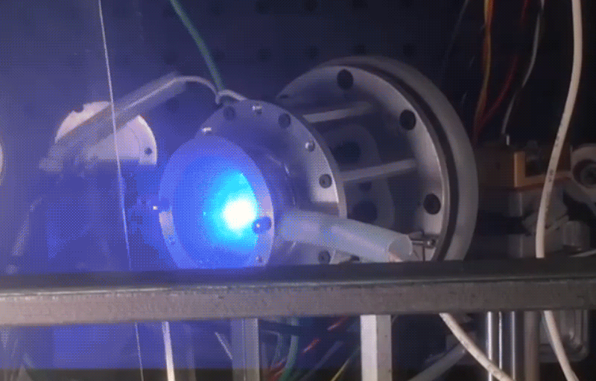
CUA FPPT pulsing at 0.5 Hz, 3 MW

